Slide 1
Equivalence of Two Popular Species Distribution Models (and one less popular too)
Dominic D LaRoche
University of Arizona Statistics GIDP
University of Arizona USGS Cooperative Fish and Wildlife Research Unit
Notes:
I want to apologize for the copious use of math throughout this presentation, but I couldn’t see any way around it. If something doesn’t make sense, or if I make a mistake, feel free to interrupt me

Slide 2
Review
Species Distribution Models use environmental covariates and location information to predict a species range
Notes:
I will start with a quick review of SDMs.

Slide 3
Review
Species Distribution Models use environmental covariates and location information to predict a species range
Data arrives in two flavors:
Notes:
There are two basic types of data: presence absence and presence ony

Slide 4
Review
Species Distribution Models use environmental covariates and location information to predict a species range
Data arrives in two flavors:
Presence/Absence

Slide 5
Review
Species Distribution Models use environmental covariates and location information to predict a species range
Data arrives in two flavors:
Presence/Absence
Presence Only

Slide 6
Review
Species Distribution Models use environmental covariates and location information to predict a species range
Data arrives in two flavors:
Presence/Absence
Presence Only
Both types have pros and cons

Slide 7
Review
Species Distribution Models use environmental covariates and location information to predict a species range
Data arrives in two flavors
Get predictions about where a species will be found

Slide 8
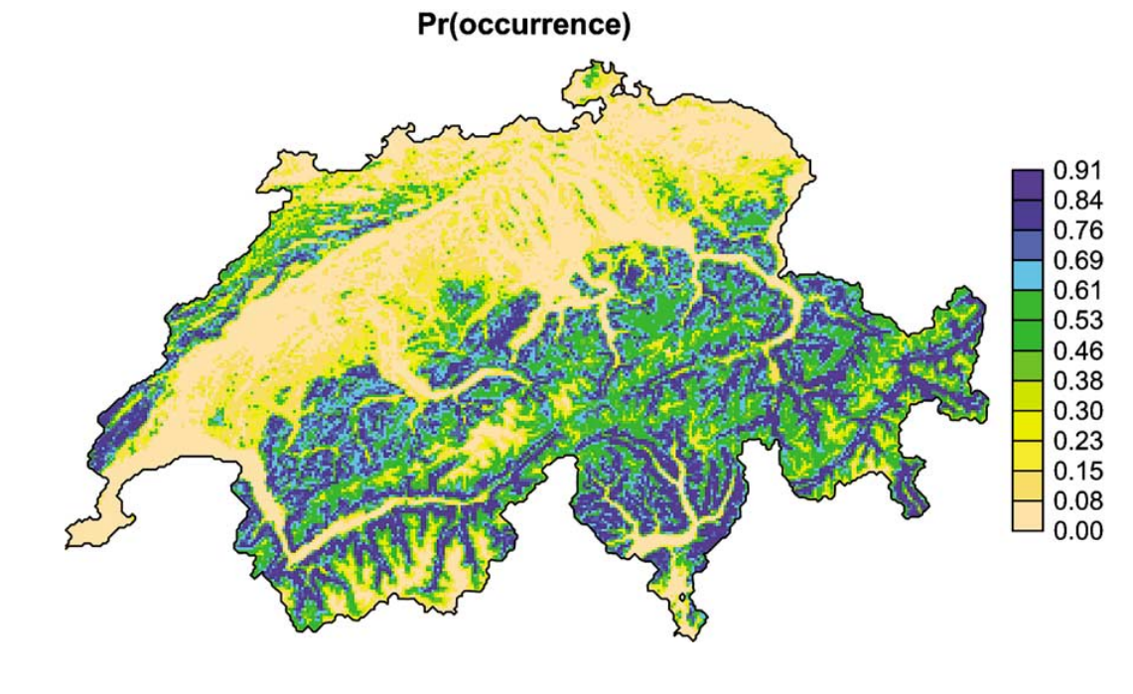
Review
Notes:
Often, these predictions are represented as the probability of occurrence. These probabilities can be either relative (e.g. MaxEnt) or absolute (e.g. logistic on presence/absence data). Examining this we can see that we are more likely to find an individual in one of these blue cells than in a yellow cell.

Slide 9
What does this mean?
Notes:
This seems straight forward enough but Fithian and Hastie point out a problem with the interpretation of these probabilities.

Slide 10
What does this mean?
Notes:
Size matters! Model interpretation depends on the sampling scheme of the data and the probability of occurrence produced from the model depends on the cell size. That is, the size of the area will influence the probability of occurrence. In the case of presence/absence data taking these issues into account can, at least, produce interpretable results.

Slide 11
What is the interpretation?
For presence/absence data the Pr(occurrence) is the probability of ≥1 individual within a cell of a particular size.

Slide 12
What is the interpretation?
For presence/absence data the Pr(occurrence) is the probability of ≥1 individual within a cell of a particular size.
For presence only data…. ???

Slide 13
What is the interpretation?
For presence/absence data the Pr(occurrence) is the probability of ≥1 individual within a cell of a particular size.
For presence only data…. ???
Not so clear because the sampling scheme is unknown (non-existent) and biased

Slide 14
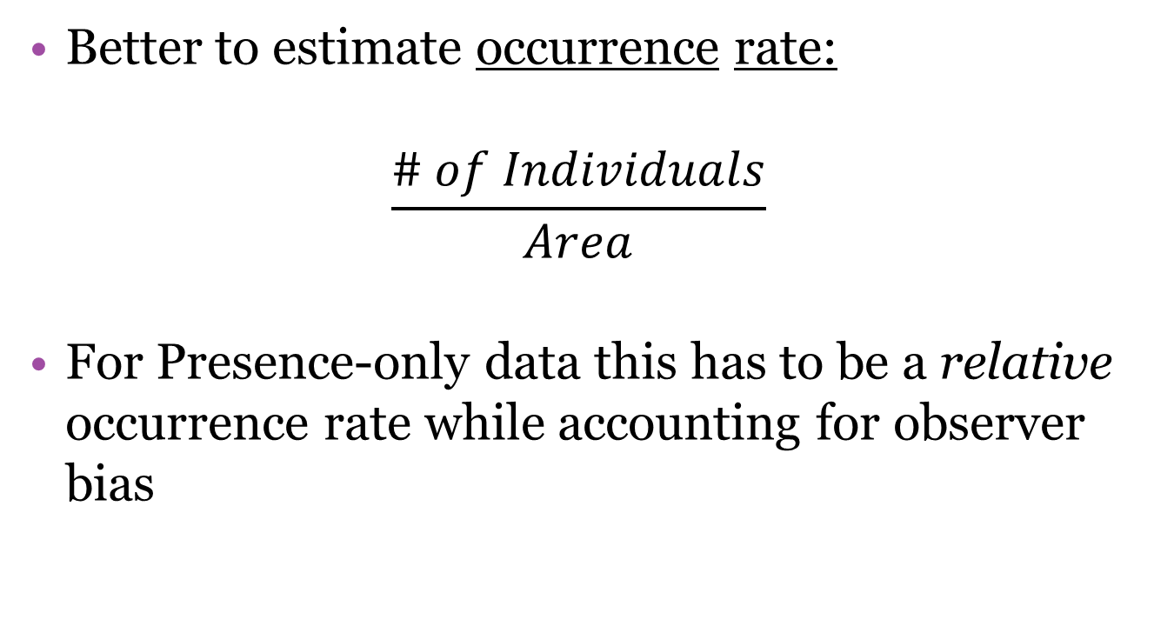
Fithian and Hastie’s Solution
Better to estimate occurrence rate:
$$\frac{\# of Individuals}{Area}$$
For Presence-only data this has to be a relative occurrence rate while accounting for observer bias
Notes:
Occurrence rate is more easily interpreted since it is not dependent on the size of the area in question. But for presence only data this must be relative occurrence due to unknown observer bias.

Slide 15
Fithian and Hastie’s Solution*
Fithian and Hastie propose the Log-linear Inhomogeneous Poisson Process (IPP) as a natural solution to this problem for presence only data sets.
Also claim IPP is a good platform to derive simple parametric forms for presence-absence and count data as well
Notes:
Not that they were the first to suggest such a model (Warton and Sheperd 2010). So lets focus on the IPP for a while and then compare it to MaxEnt and logistic regression.

Slide 16

Notation:
$D⊆{ℝ }^{2}$
Total area of $D=1$
Notes:
I will start with some notation which I will use for the rest of the talk.

Slide 17

Notation:
$D⊆{ℝ }^{2}$
Total area of $D=1$
$z_{i}$ is a geographic location in D

Slide 18

Notation:
$D⊆{ℝ }^{2}$
Total area of $D=1$
$z_{i}$ is a geographic location in D
$x_{i}=x(z_{i})$ is a vector of measured features at $z_{i}$

Slide 19
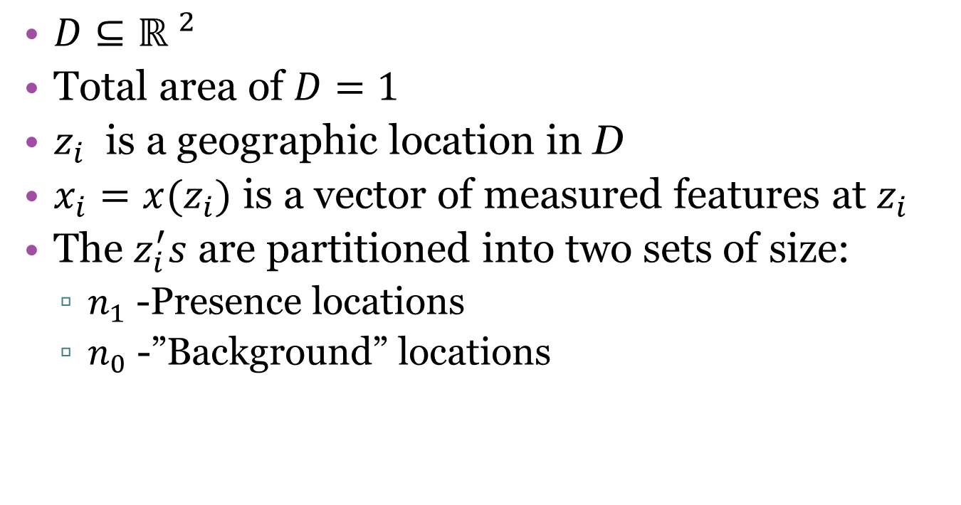
Notation:
$D⊆{ℝ }^{2}$
Total area of $D=1$
$z_{i}$ is a geographic location in D
$x_{i}=x(z_{i})$ is a vector of measured features at $z_{i}$
The $z_{i}^{′}s$ are partitioned into two sets of size:
$n_{1}$ -Presence locations
$n_{0}$ -”Background” locations
Notes:
The locations are partitioned into two sets of size n₁ and n₀, corresponding to the presence and background locations respectively. Here you see the familiar “psuedo-absences” of MaxEnt and logistic regression, but here they are treated a little differently and I will go into that a little more later on.

Slide 20
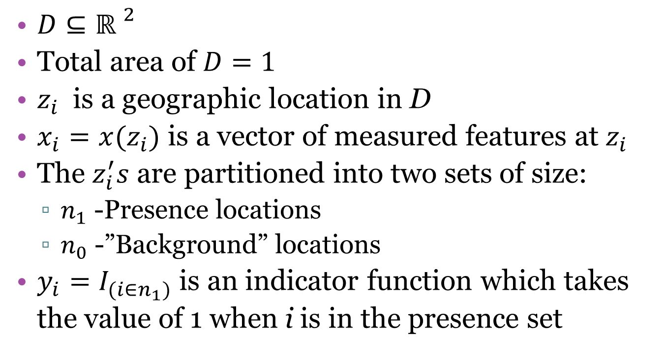
Notation:
$D⊆{ℝ }^{2}$
Total area of $D=1$
$z_{i}$ is a geographic location in D
$x_{i}=x(z_{i})$ is a vector of measured features at $z_{i}$
The $z_{i}^{′}s$ are partitioned into two sets of size:
$n_{1}$ -Presence locations
$n_{0}$ -”Background” locations
$y_{i}=I_{(i∈n_{1})}$ is an indicator function which takes the value of 1 when i is in the presence set

Slide 21
The IPP Model
Both the number of points and their locations are random
Notes:
In the IPP, both the number of points an their locations are random. This fits well with presence only data since you can think of an observation as a random event.

Slide 22

The IPP Model
Both the number of points and their locations are random
Begin with an intensity function λ:
For $A ⊆D, Λ\left(A\right)=\int_{A}^{ }{λ\left(z\right)dz},$where $Λ\left(D\right)<∞$
Notes:
The intensity function is the first order moment (like the mean of a normal R.V.). λ(z) Can be interpreted as the probability that there is a point in some infinitesimal volume around z. If the process X is stationary then then λ(B)=τν(B), where tau is a constant intensity of the PP X and can be interpreted as the mean number of points of X per unit volume. A poisson PP belongs to the class of PP with complete spatial randomness, this means that points are distributed independently of each other. Poisson PPs do not necessarily have uniform density even though they are IID in space.

Slide 23
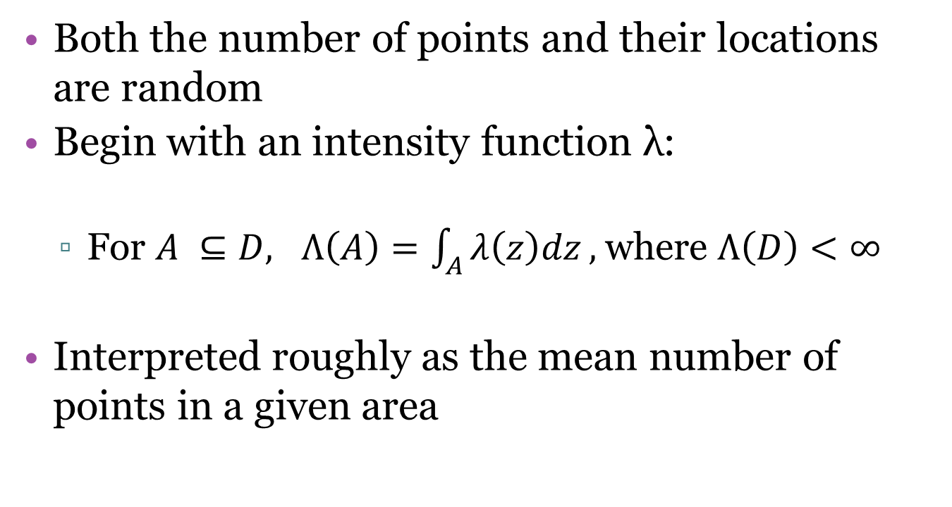
The IPP Model
Both the number of points and their locations are random
Begin with an intensity function λ:
For $A ⊆D, Λ\left(A\right)=\int_{A}^{ }{λ\left(z\right)dz},$where $Λ\left(D\right)<∞$
Interpreted roughly as the mean number of points in a given area
Notes:
The intensity function is the first order moment (like the mean of a normal R.V.). λ(z) Can be interpreted as the probability that there is a point in some infinitesimal volume around z. If the process X is stationary then then λ(B)=τν(B), where tau is a constant intensity of the PP X and can be interpreted as the mean number of points of X per unit volume. A poisson PP belongs to the class of PP with complete spatial randomness, this means that points are distributed independently of each other. Poisson PPs do not necessarily have uniform density even though they are IID in space.

Slide 24
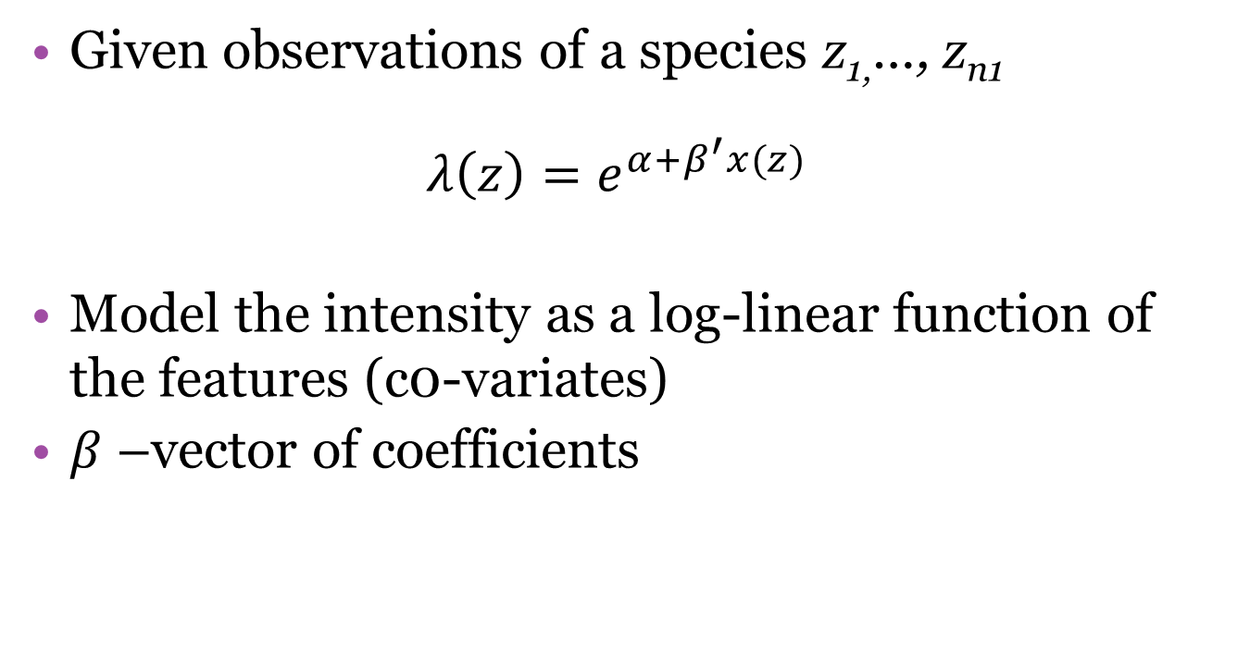
The IPP Model
Given observations of a species z_{1,}…, z_{n1}
$$λ\left(z\right)=e^{α+β^{′}x(z)}$$
Model the intensity as a log-linear function of the features (c0-variates)
$β$ –vector of coefficients
Notes:
One can model the intensity as a log-linear function of the environmental features at each presence observation (1 through n₁). The vector of estimates/ coefficients for each feature is beta.

Slide 25
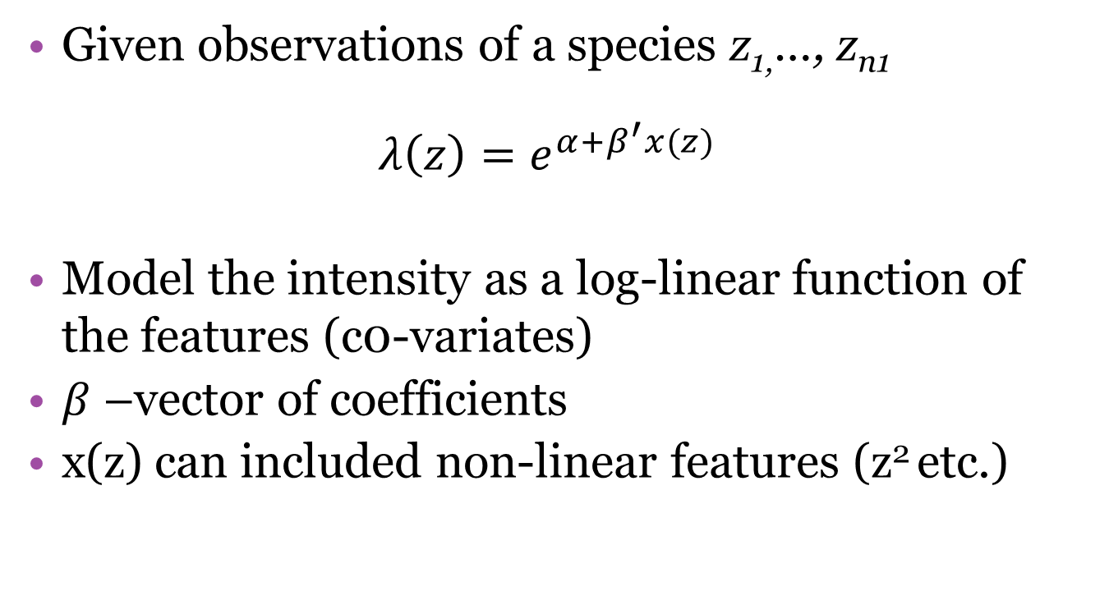
The IPP Model
Given observations of a species z_{1,}…, z_{n1}
$$λ\left(z\right)=e^{α+β^{′}x(z)}$$
Model the intensity as a log-linear function of the features (c0-variates)
$β$ –vector of coefficients
x(z) can included non-linear features (z² etc.)
Notes:
There is no constraint on the features so you can include all manner of non-linear terms here to make for a very flexible model.

Slide 26

The IPP Model: $λ\left(z\right)=e^{α+β^{′}x(z)}$
Can interpret the IPP as a simple random sample with a random size
Notes:
We can also think of the IPP as a simple random sample with a random size. This makes sense in the presence only scenario since we are not using a systematic sampling scheme and, therefore, the observations are random events.

Slide 27
The IPP Model: $λ\left(z\right)=e^{α+β^{′}x(z)}$
Can interpret the IPP as a simple random sample with a random size
α is just a scaling parameter which adjusts to fit the number of presence observations (sample size)
Notes:
In this case, the parameter alpha is just a scaling parameter which adjusts to fit the number of observations.

Slide 28
The IPP Model: $λ\left(z\right)=e^{α+β^{′}x(z)}$
Can interpret the IPP as a simple random sample with a random size
α is just a scaling parameter which adjusts to fit the number of presence observations (sample size)
β completely determines the intensity at a point
Notes:
And beta completely determines the intensity at a point.

Slide 29
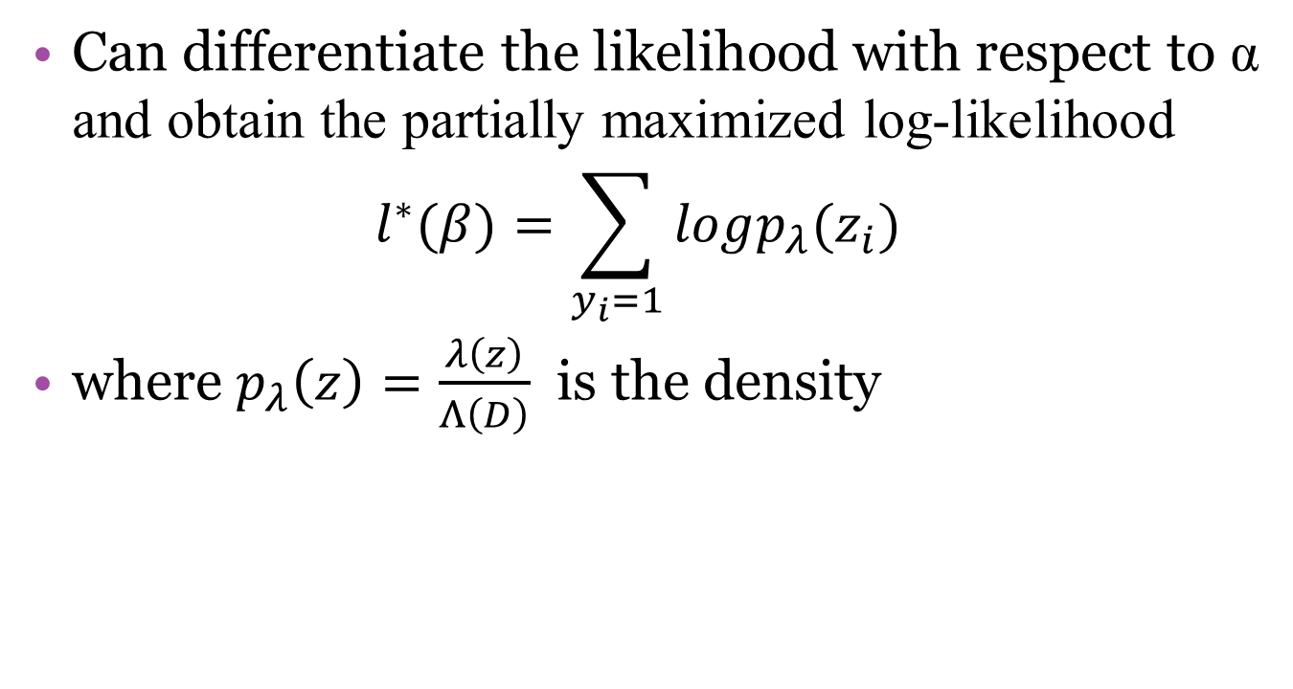
The IPP Model: $λ\left(z\right)=e^{α+β^{′}x(z)}$
Can differentiate the likelihood with respect to α and obtain the partially maximized log-likelihood
$$l^{∗}(β)=\sum_{y_{i}=1}{logp_{λ}(z_{i})}$$
where $p_{λ}\left(z\right)=\frac{λ\left(z\right)}{Λ\left(D\right)}$ is the density
Notes:
In fact, Fithian and Hastie show that you can differentiate the likelihood with respect to alpha and then obtain a partially maximized likelihood. After ignoring the constants this is what you get, which can be interpreted as a simple random sample from the intensity surface. The take home here is that alpha is not really of scientific interest in presence only samples but rather just encodes the total number of records available.

Slide 30
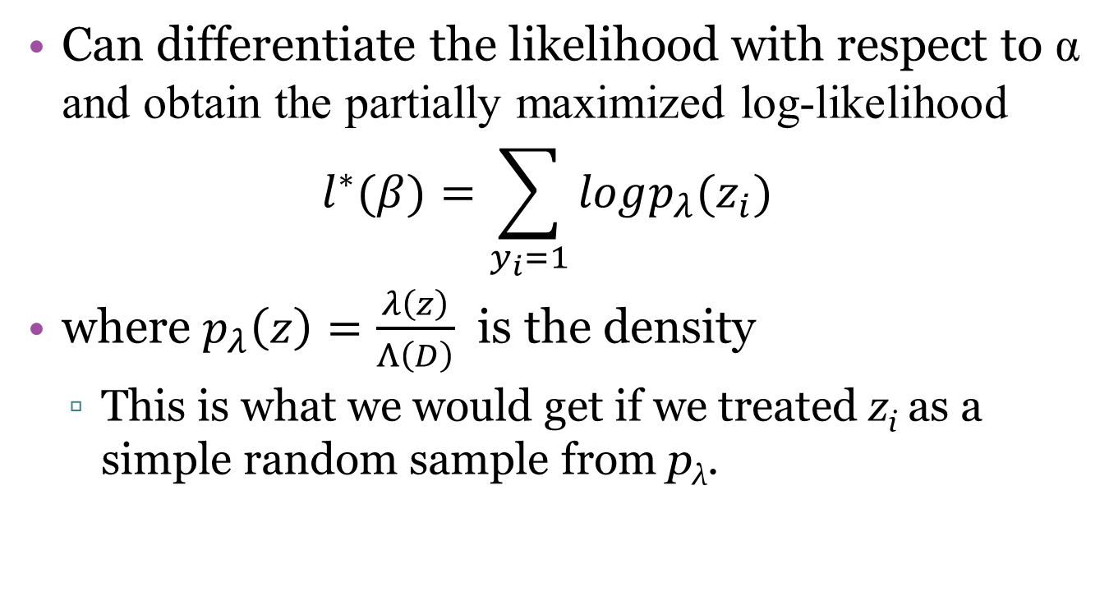
The IPP Model: $λ\left(z\right)=e^{α+β^{′}x(z)}$
Can differentiate the likelihood with respect to α and obtain the partially maximized log-likelihood
$$l^{∗}(β)=\sum_{y_{i}=1}{logp_{λ}(z_{i})}$$
where $p_{λ}\left(z\right)=\frac{λ\left(z\right)}{Λ\left(D\right)}$ is the density
This is what we would get if we treated z_{i} as a simple random sample from p_{λ}.
Notes:
One could differentiate the likelihood with respect to alpha and then obtain a partially maximized likelihood. After ignoring the constants this is what you get, which can be interpreted as a simple random sample from the intensity surface. The take home here is that alpha is not really of scientific interest but rather just encodes the total number of records available.

Slide 31
The IPP Model
Maximizing the full likelihood essentially;
Notes:
Now, if we maximize the full likelihood..

Slide 32
The IPP Model
Maximizing the full likelihood essentially;
Finds β such that p_{λ} matches the means of the features in the presence samples
Notes:
Does this sound familiar? If you remember back a couple weeks to the MaxEnt description that Margaret gave this sounds pretty familiar. This is analogous to the “constraints” in MaxEnt!

Slide 33
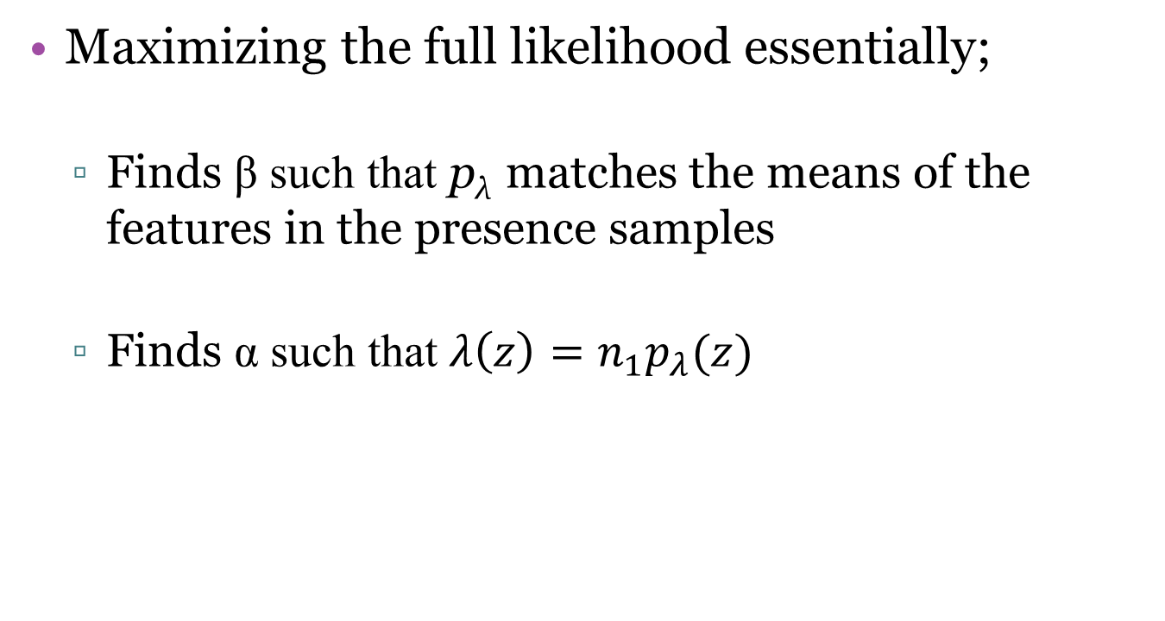
The IPP Model
Maximizing the full likelihood essentially;
Finds β such that p_{λ} matches the means of the features in the presence samples
Finds α such that $λ\left(z\right)=n_{1}p_{λ}(z)$
Notes:
Recall that n₁ is the sample of observations, this is just finding alpha which makes the estimated intensity match the realized intensity. If n₁ doesn’t have any meaningful interpretation then neither does alpha. In the presence/absence arena n₁ can and does have meaning (think abundance estimate!)

Slide 34
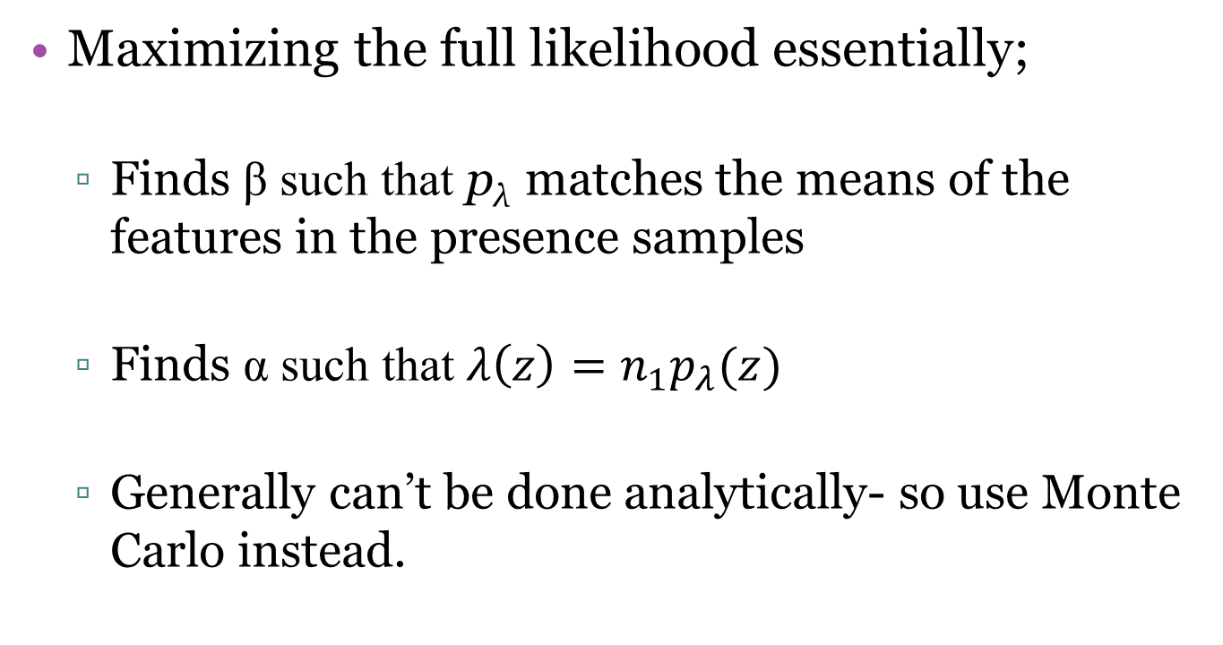
The IPP Model
Maximizing the full likelihood essentially;
Finds β such that p_{λ} matches the means of the features in the presence samples
Finds α such that $λ\left(z\right)=n_{1}p_{λ}(z)$
Generally can’t be done analytically- so use Monte Carlo instead.
Notes:
These likelihood equations generally cannot be solved analytically so, in practice, they are evaluated via Monte Carlo with a numerical approximation.

Slide 35

The IPP Model
The likelihood:
$$l\left(α,β\right)=\sum_{y_{i}=1}{α+β^{′}x_{i}}−\int_{D}^{ }{e^{α+β^{′}x(z)}}dz$$

Slide 36
The IPP Model
The likelihood:
$$l\left(α,β\right)=\sum_{y_{i}=1}{α+β^{′}x_{i}}−\int_{D}^{ }{e^{α+β^{′}x(z)}}dz$$
Notes:
The equation can be logically divided into two parts: the presence sample …

Slide 37
The IPP Model
The likelihood:
$$l\left(α,β\right)=\sum_{y_{i}=1}{α+β^{′}x_{i}}−\int_{D}^{ }{e^{α+β^{′}x(z)}}dz$$
Notes:
And the total area D.

Slide 38
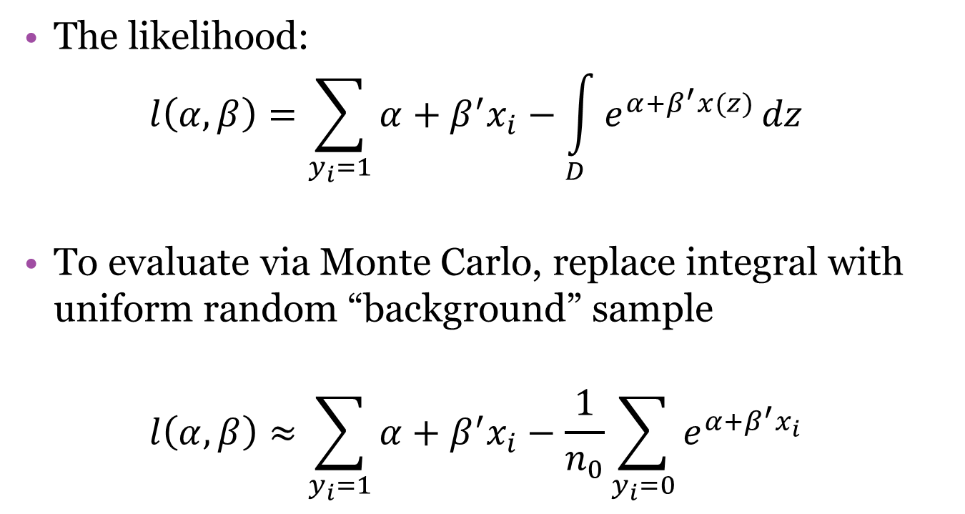
The IPP Model
The likelihood:
$$l\left(α,β\right)=\sum_{y_{i}=1}{α+β^{′}x_{i}}−\int_{D}^{ }{e^{α+β^{′}x(z)}}dz$$
To evaluate via Monte Carlo, replace integral with uniform random “background” sample
$$l\left(α,β\right)≈\sum_{y_{i}=1}{α+β^{′}x_{i}}−\frac{1}{n_{0}}\sum_{y_{i}=0}{e^{α+β^{′}x_{i}}}$$
Notes:
We can approximate the integral in the second half of this equation with a uniform random sample of “background” points. There are multiple ways to do this, essentially we need to make this solution tractable. Fithian and Hastie call this second equation the “numerical IPP”. Notice that I haven’t defined the area D yet. The definition of this area is potentially very important biologically and determines how the background is chosen. So far we have no solution to the generalizability problem I discussed last time (overfitting issue). I will come back to this point later.

Slide 39
The IPP Model: Observer Bias
Presence-only and presence/absence data only represent an observation process
λ_{obs}(z)=λ_{occ}(z)s(z)
It is likely that s(z) is a function of the environment.
Notes:
When we collect data, with either presence/absence or presence only data, we are recording an observation process which I mentioned in my previous talk. Our observations are probably not an unbiased representation of the occurences. The actual occurrence process is most likely translated to an observation process through some unknown function of the environment. Moreover, the environmental features that affect the observation process may or may not affect the occurrence process.

Slide 40
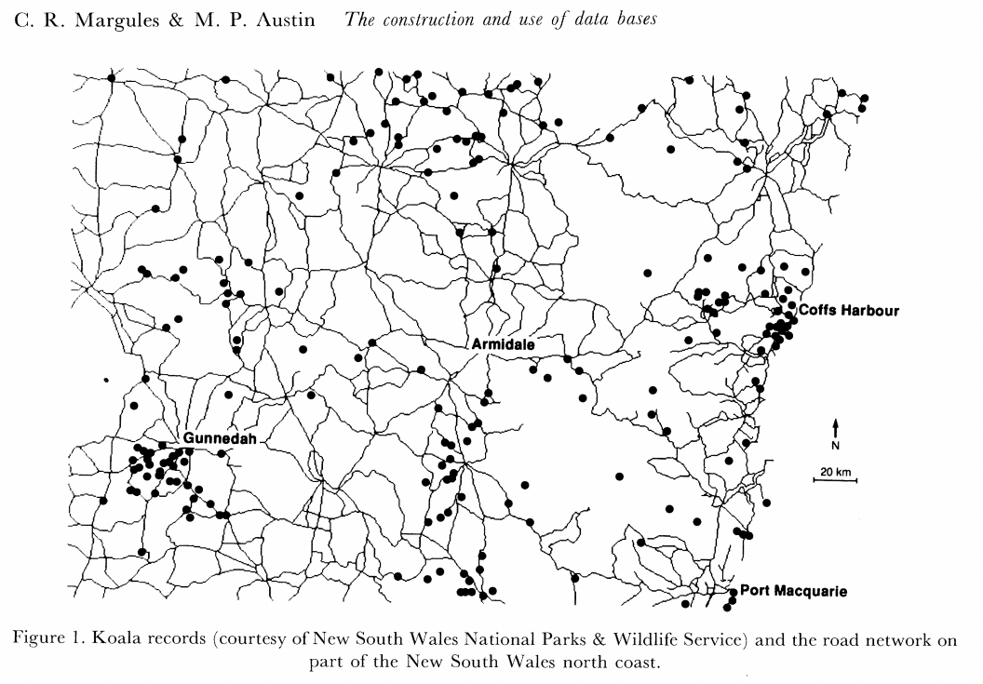
The IPP Model: Observer Bias
Notes:
For example, from this data of Koala sightings we do not know whether Koalas really like roads or whether we are just much more likely to observe one along a road because, lets face it, people really like roads. That doesn’t mean that koalas don’t aggregate near roads, perhaps there are hedge rows of eucalyptus trees along roads which provide good habitat. We simply don’t know from this data since it wasn’t systematically collected.

Slide 41

The IPP Model: Observer Bias
Can directly model observer bias
$$λ_{obs}=e^{\tilde{α}+\tilde{β^{′}}x_{1}(z)}e^{γ+δ^{′}x_{2}(z)}$$
Notes:
With the IPP one can directly model this observer bias (or detection probability) as a function of the environment. Here x₁ represents the features which affect occurrence and x₂ represents the features which affect an observation.

Slide 42
The IPP Model: Observer Bias
Can directly model observer bias
$$λ_{obs}=e^{\tilde{α}+\tilde{β^{′}}x_{1}(z)}e^{γ+δ^{′}x_{2}(z)}$$
Notes:
With the IPP one can directly model this observer bias (or detection probability) as a function of the environment. Here x₁ represents the features which affect occurrence and x₂ represents the features which affect an observation.

Slide 43
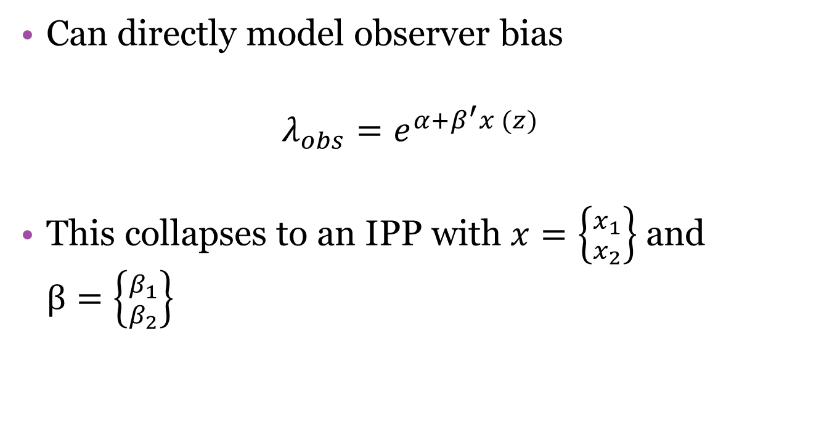
The IPP Model: Observer Bias
Can directly model observer bias
$$λ_{obs}=e^{α+β^{′}x (z)}$$
This collapses to an IPP with $x=\left\{{x_{1} \atop x_{2}}\right\}$ and $β=\left\{{β_{1} \atop β_{2}}\right\}$
Notes:
With the IPP one can directly model this observer bias (or detection probability) as a function of the environement. Here x₁ represents the features which affect occurrence and x₂ represents the features which affect an observation. Of course, this only removes the bias if you do a good job of modeling it. Also, apparently, a poor specification of this model could worsen the bias problem.

Slide 44
MaxEnt: Review
Make the estimate as close to uniform while still satisfying constraints imposed by the data.
Choose a p which maximizes H(p) such that the expectations of the features x(z) match the sample means of those features

Slide 45

MaxEnt
Philips et al (2004):
$$p\left(z\right)=\frac{e^{β^{′}x(z)}}{\int_{D}^{ }{e^{β^{′}x(u)}du}}$$
Notes:
Philips et al show that the MaxEnt criteria is equivalent to maximizing the likelihood of this parametric model.

Slide 46
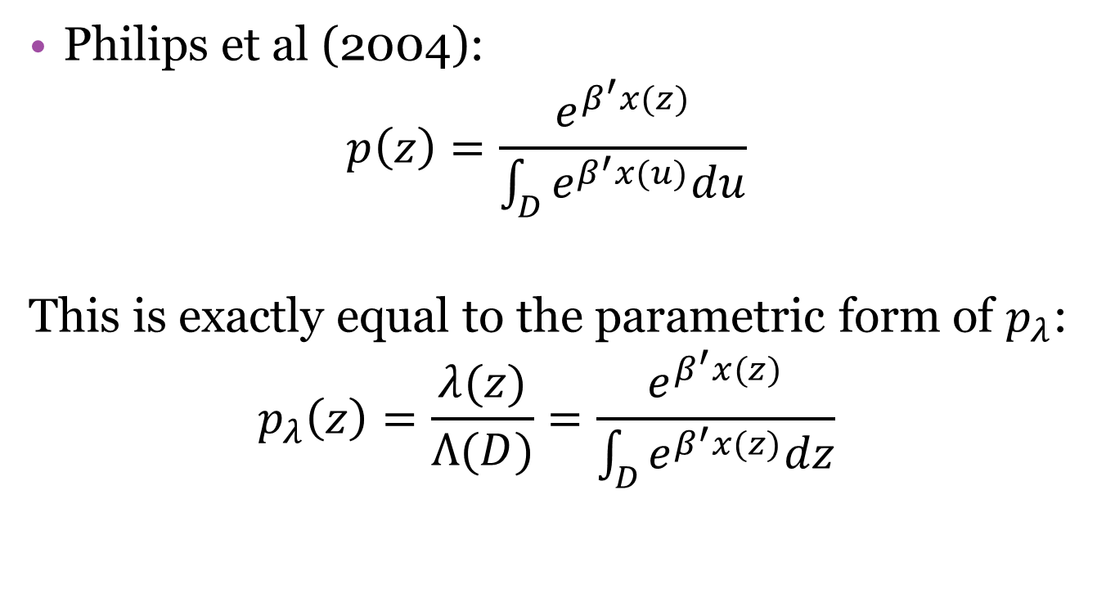
MaxEnt
Philips et al (2004):
$$p\left(z\right)=\frac{e^{β^{′}x(z)}}{\int_{D}^{ }{e^{β^{′}x(u)}du}}$$
This is exactly equal to the parametric form of $p_{λ}$:
$$p_{λ}\left(z\right)=\frac{λ(z)}{Λ(D)}=\frac{e^{β^{′}x(z)}}{\int_{D}^{ }{e^{β^{′}x(z)}dz}}$$
Notes:
Philips et al show that the MaxEnt criteria is equivalent to maximizing the likelihood of this parametric model. Which we can see is equivalent to the parametric form of the IPP intensity.

Slide 47
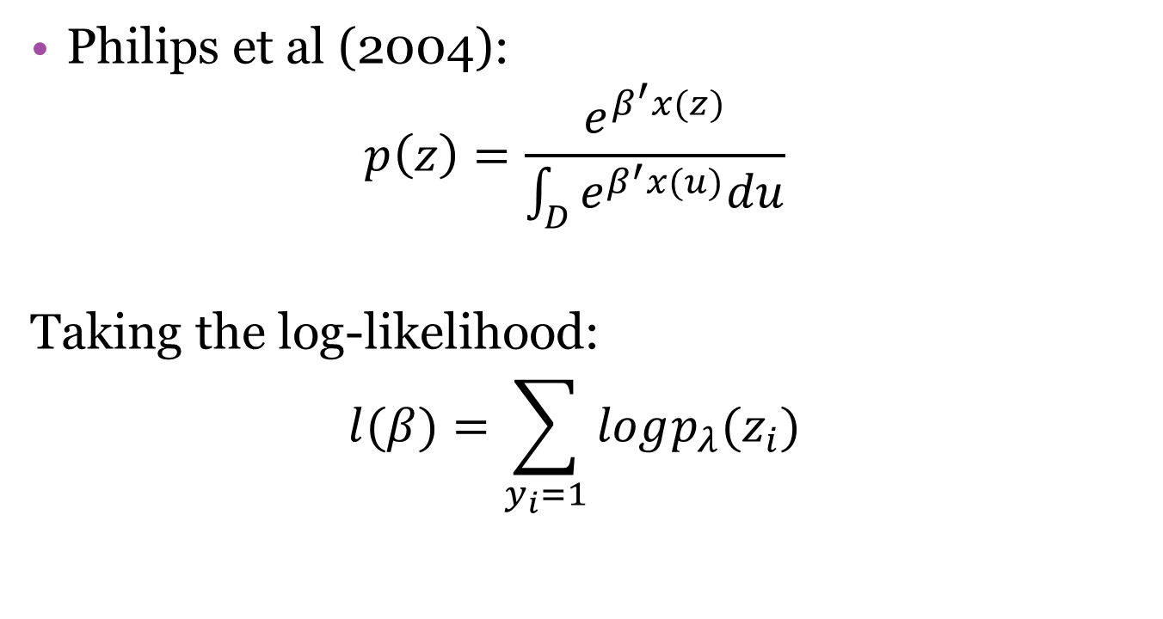
MaxEnt
Philips et al (2004):
$$p\left(z\right)=\frac{e^{β^{′}x(z)}}{\int_{D}^{ }{e^{β^{′}x(u)}du}}$$
Taking the log-likelihood:
$$l(β)=\sum_{y_{i}=1}{logp_{λ}(z_{i})}$$
Notes:
If we take the log likelihood we get the exact solution to the partially maximized IPP solution! As it turns out, the constraints imposed by MaxEnt are equivalent to the score equations for beta in an IPP. That means that the solutions to beta are identical. The actual MaxEnt package automatically generates a large basis expansion of the original features into a derived set of features which include quadratic terms, interactions, step functions, etc. The same sort of approach can be taken with the IPP so long as the regularization is only applied to beta and not alpha.

Slide 48

(What MaxEnt really fits)
$$\sum_{y_{i}=1}{β^{′}x_{i}−n_{1}log\left(\int_{D}^{ }{e^{β^{′}x(z)}dz}\right)−\sum_{j}{r_{j}|β_{j}|}}$$
Notes:
Where the regularization terms are specified by the software based on numerous presence only data sets.

Slide 49

Logistic Regression: Review
$$P\left(y_{i}=1 | x_{i}\right)=\frac{e^{η+β^{′}x_{i}^{}}}{1+e^{η+β^{′}x_{i}^{}}}$$
Treats n₁, n₀, and x_{i} as fixed

Slide 50
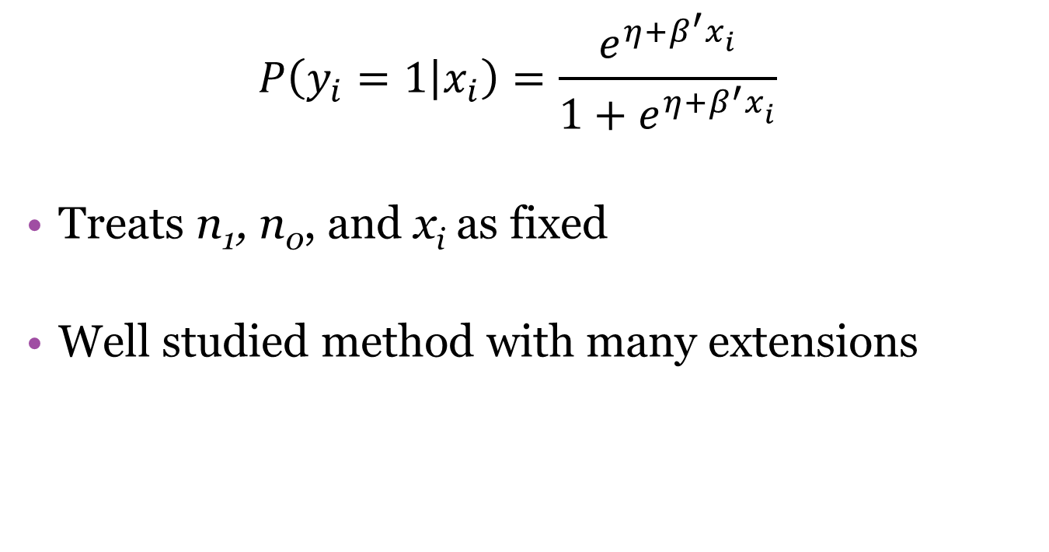
Logistic Regression: Review
$$P\left(y_{i}=1 | x_{i}\right)=\frac{e^{η+β^{′}x_{i}^{}}}{1+e^{η+β^{′}x_{i}^{}}}$$
Treats n₁, n₀, and x_{i} as fixed
Well studied method with many extensions

Slide 51
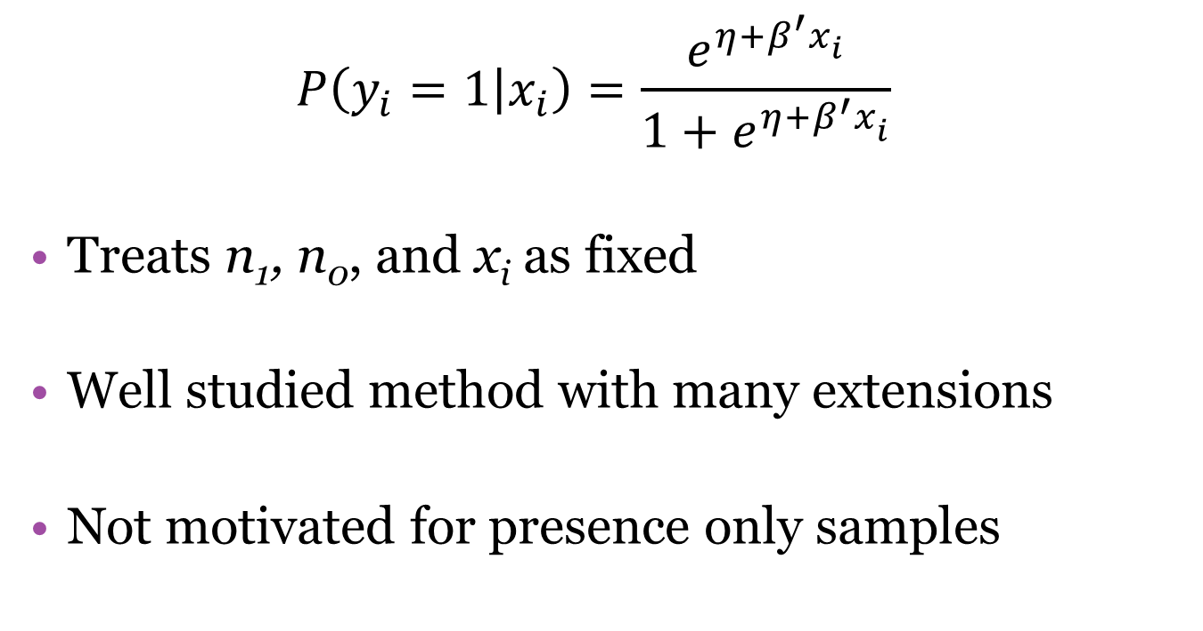
Logistic Regression: Review
$$P\left(y_{i}=1 | x_{i}\right)=\frac{e^{η+β^{′}x_{i}^{}}}{1+e^{η+β^{′}x_{i}^{}}}$$
Treats n₁, n₀, and x_{i} as fixed
Well studied method with many extensions
Not motivated for presence only samples
Notes:
The interpretation of the logistic regression model is a little murky since it wasn’t really motivated by presence only data. A sample of “background” points are chosen from geographic space but the sampling unit isn’t always clear. For example, if you randomly select a point in space, what is the chance there is a species of interest there? If you think about just on the point the probability is near 0 (continuous space this is exactly 0). If we extend the size of the area the probability gets larger and larger.

Slide 52
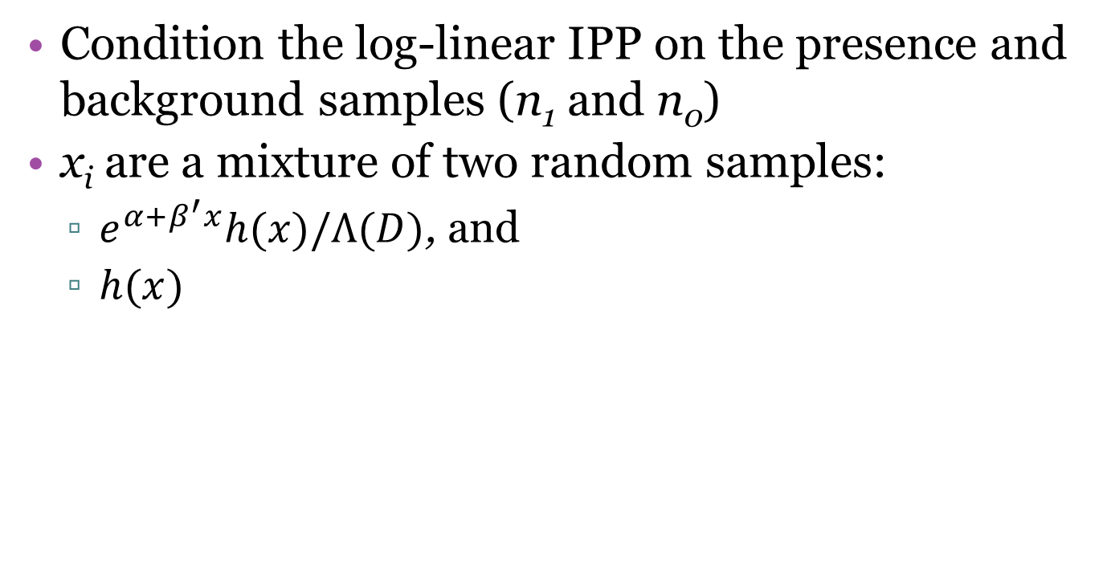
Logistic Regression: Equivalence
Condition the log-linear IPP on the presence and background samples (n₁ and n₀)
x_{i} are a mixture of two random samples:
$e^{α+β^{′}x}h(x)/Λ(D)$, and
$h(x)$

Slide 53
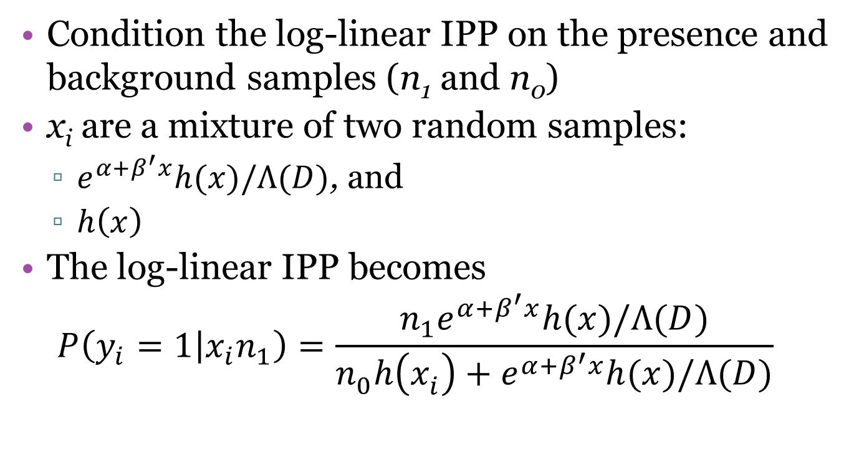
Logistic Regression: Equivalence
Condition the log-linear IPP on the presence and background samples (n₁ and n₀)
x_{i} are a mixture of two random samples:
$e^{α+β^{′}x}h(x)/Λ(D)$, and
$h\left(x\right)$
The log-linear IPP becomes
$$P\left(y_{i}=1 | x_{i}n_{1}\right)=\frac{n_{1}e^{α+β^{′}x}h(x)/Λ(D)}{{n_{0}^{}h\left(x_{i}^{}\right)+e}^{α+β^{′}x}h(x)/Λ(D)}$$

Slide 54

Logistic Regression: Equivalence
Substituting $\frac{n_{1}e^{α}}{n_{0}Λ\left(D\right)}=e^{n}$, you get the equivalent:
$$P\left(y_{i}=1 | x_{i}\right)=\frac{e^{η+β^{′}x_{i}^{}}}{1+e^{η+β^{′}x_{i}^{}}}$$

Slide 55
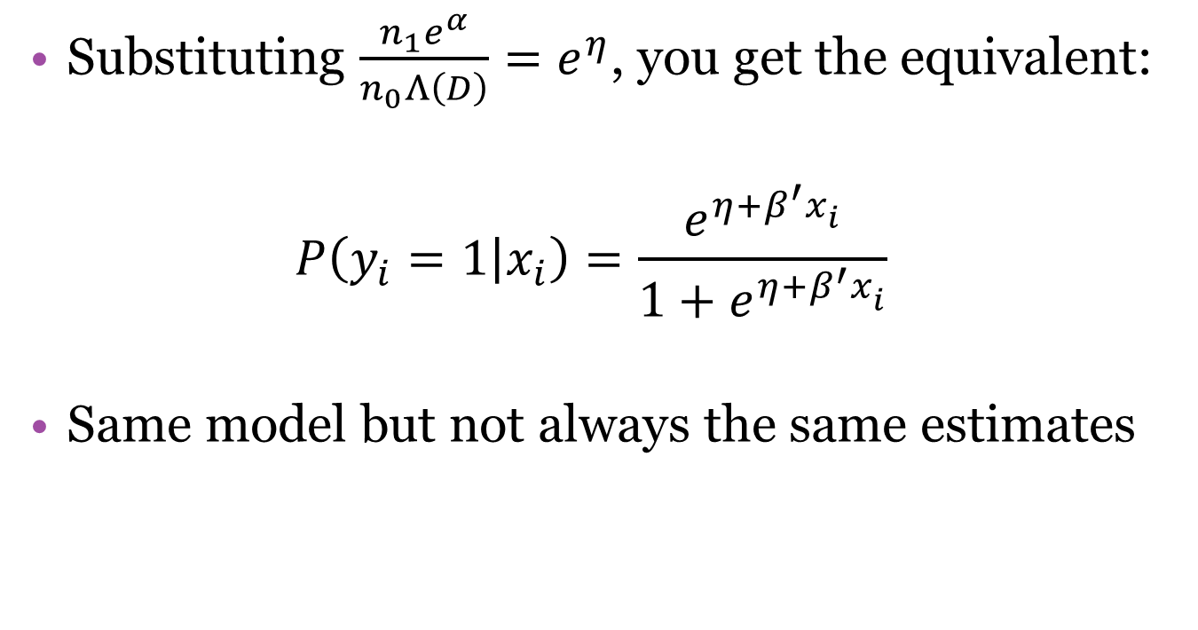
Logistic Regression: Equivalence
Substituting $\frac{n_{1}e^{α}}{n_{0}Λ\left(D\right)}=e^{η}$, you get the equivalent:
$$P\left(y_{i}=1 | x_{i}\right)=\frac{e^{η+β^{′}x_{i}^{}}}{1+e^{η+β^{′}x_{i}^{}}}$$
Same model but not always the same estimates
Notes:
Even though we can reduce the log-linear IPP to the same form as the logistic regression by conditioning on the sample size, we do not necessarily get the same estimates for beta, the covariate effects.

Slide 56
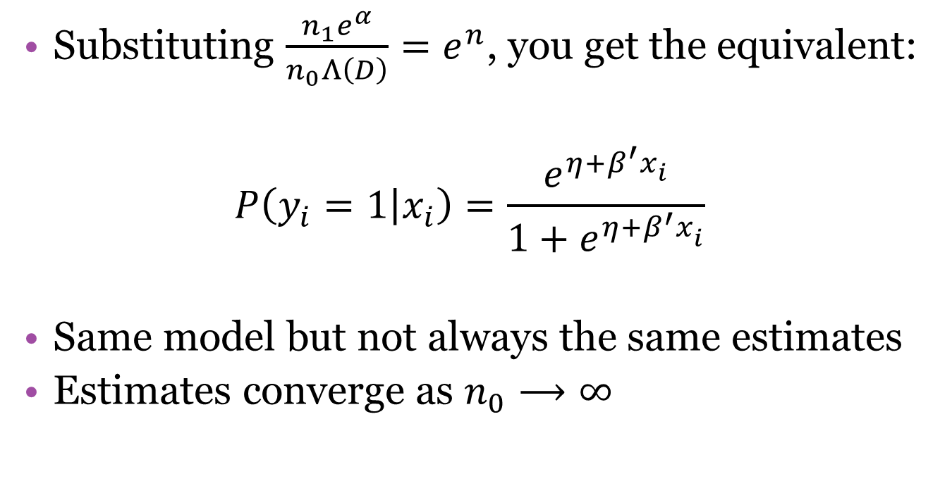
Logistic Regression: Equivalence
Substituting $\frac{n_{1}e^{α}}{n_{0}Λ\left(D\right)}=e^{n}$, you get the equivalent:
$$P\left(y_{i}=1 | x_{i}\right)=\frac{e^{η+β^{′}x_{i}^{}}}{1+e^{η+β^{′}x_{i}^{}}}$$
Same model but not always the same estimates
Estimates converge as $n_{0}⟶∞$
Notes:
However, both the logistic regression estimate and the log linear IPP estimate are consistent for beta so the two estimates will converge as the background sample gets very large. Warton and Shepherd already discovered this property in 2010. Moreover, n₁ generally has to stay fixed for this to occur (since models are usually misspecified).

Slide 57
Logistic Regression: But Wait!
This isn’t terribly useful since we cannot use an infinite number of background points in practice
Notes:
Since we cannot realistically use an infinite number of background points in practice these two models will not generally provide the same results. Moreover, an infinite number of background points might not make sense biologically.

Slide 58
Logistic Regression: But Wait!
This isn’t terribly useful since we cannot use an infinite number of background points in practice
Can get around this using weighted logistic regression
Notes:
However, Fithian and Hastie propose a solution to this using weighted logistic regression.

Slide 59

Weighted Logistic Regression
Assign weights to the samples:
$$w_{i}=\left\{\begin{aligned}W if y_{i}=0 \\ 1 otherwise\end{aligned}\right.$$
Notes:
First , assign weights to the samples – specifically the background samples.

Slide 60
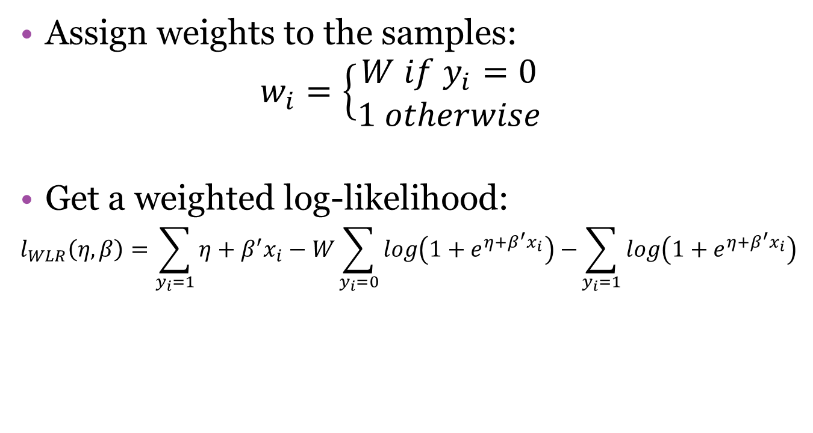
Weighted Logistic Regression
Assign weights to the samples:
$$w_{i}=\left\{\begin{aligned}W if y_{i}=0 \\ 1 otherwise\end{aligned}\right.$$
Get a weighted log-likelihood:
$$l_{WLR}\left(η,β\right)=\sum_{y_{i}=1}{η+β^{′}x_{i}−W}\sum_{y_{i}=0}{log\left(1+e^{η+β^{′}x_{i}}\right)−}\sum_{y_{i}=1}{log\left(1+e^{η+β^{′}x_{i}}\right)}$$
Notes:
Then you get a weighted log-likelihood that looks like this…

Slide 61
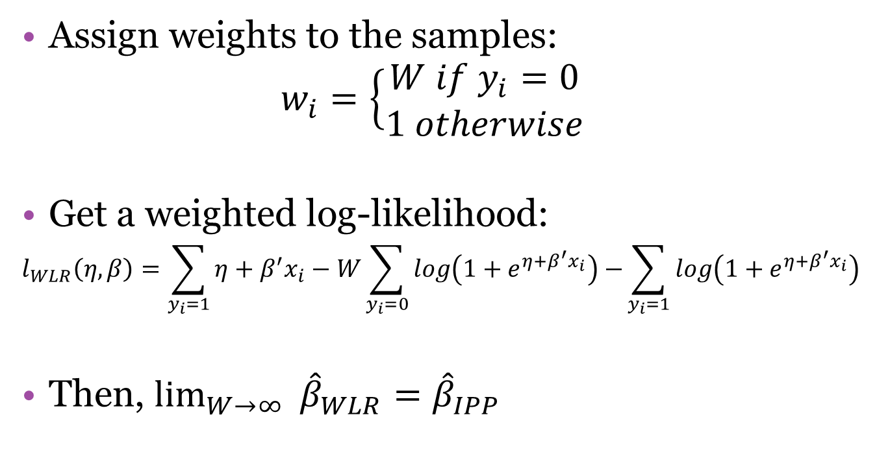
Weighted Logistic Regression
Assign weights to the samples:
$$w_{i}=\left\{\begin{aligned}W if y_{i}=0 \\ 1 otherwise\end{aligned}\right.$$
Get a weighted log-likelihood:
$$l_{WLR}\left(η,β\right)=\sum_{y_{i}=1}{η+β^{′}x_{i}−W}\sum_{y_{i}=0}{log\left(1+e^{η+β^{′}x_{i}}\right)−}\sum_{y_{i}=1}{log\left(1+e^{η+β^{′}x_{i}}\right)}$$
Then, $\lim_{W→∞ }{{\hat{β}}_{WLR}={\hat{β}}_{IPP}}$
Notes:
Taking the limit as W approaches inf. the two estimates of beta are equivalent.

Slide 62
Weighted Logistic Regression
WLR becomes a density estimation like IPP and MaxEnt

Slide 63
Weighted Logistic Regression
WLR becomes a density estimation like IPP and MaxEnt
Becomes conceptually the same

Slide 64
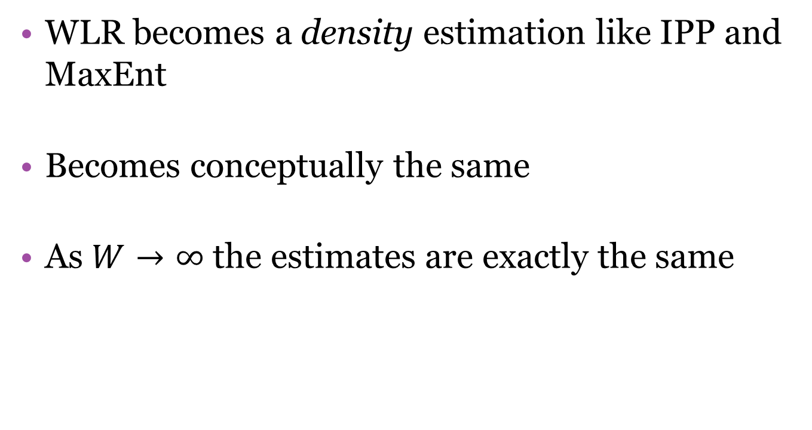
Weighted Logistic Regression
WLR becomes a density estimation like IPP and MaxEnt
Becomes conceptually the same
As $W→∞$ the estimates are exactly the same

Slide 65
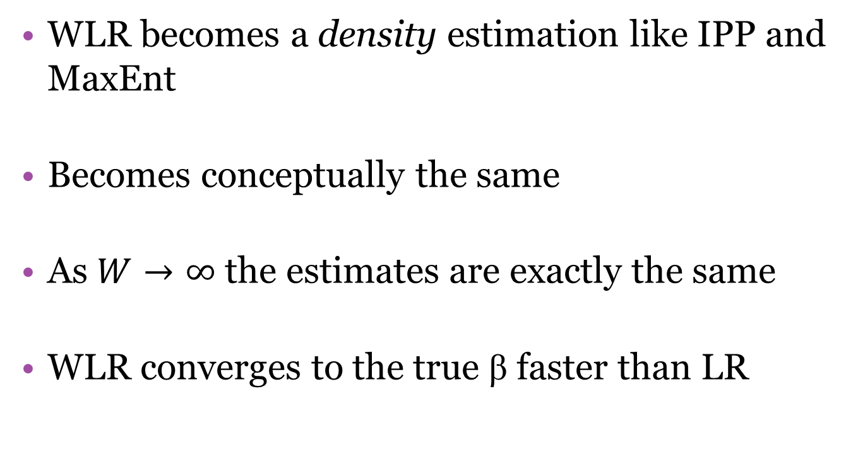
Weighted Logistic Regression
WLR becomes a density estimation like IPP and MaxEnt
Becomes conceptually the same
As $W→∞$ the estimates are exactly the same
WLR converges to the true β faster than LR
Notes:
Moreover, WLR converges much more quickly to the true beta than traditional LR

Slide 66
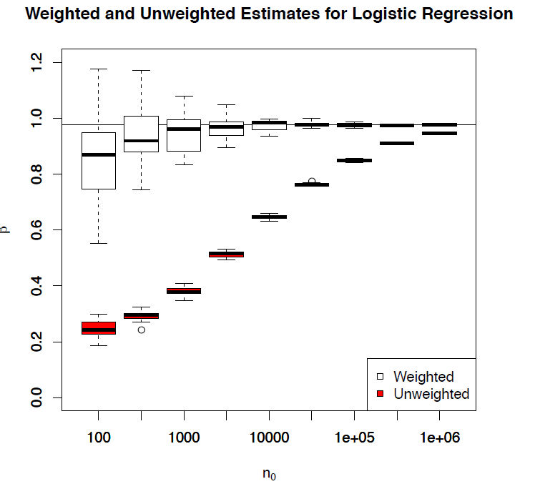
WLR vs LR
Notes:
Fithian and Hastie performed a simulation and demonstrated the better convergence properties of weighted logistic regression for density estimation. (20 replicates per n₀)

Slide 67
Additional Applications
Combine presence/absence and presence only data to estimate observer bias

Slide 68
The Unifying IPP
The IPP is a unifying model
Logistic regression can be viewed as density estimation models
Extensions of one are equally applied to the other two

Slide 69
Questions?

